Slide 1
Behavioural & Experimental Economics Intertemporal Choice
Lunzheng Li
University of Cyprus

Slide 2
Unsolved Exercise
You won a free ticket to see an Eric Clapton concert (which has no resale value).
Bob Dylan is performing on the same night and is your next-best alternative activity. Tickets to see Dylan cost $40. On any given day, you would be willing to pay up to $50 to see Dylan.
Assume there are no other costs of seeing either performer. Based on this information, what is the opportunity cost of seeing Eric Clapton?
$0,
$10,
$40,
$50.
Opportunity cost is the value of the best alternative forgone in making any choice.

Slide 3
Course Outline
Choice under Certainty
Judgement under Risk & Uncertainty
Choices under Risk & Uncertainty
Intertemporal Choice
Strategic Interaction

Slide 4
Course Outline
Choice under Certainty
Judgement under Risk & Uncertainty
Choices under Risk & Uncertainty
Intertemporal Choice
The discounted utility model
Biases in intertemporal choice
Strategic Interaction

Slide 5
Intertemporal choice
Up to now, we have examined decision problems in which outcomes were assumed to be instantaneous or at least simultaneous.
Often, time is a factor:
Different outcomes happen at different points in time.
Choices are associated with streams of outcomes.
What happens with preferences over time?
Time may also add uncertainty, but we will ignore this here.

Slide 6
Interest rates

Slide 7
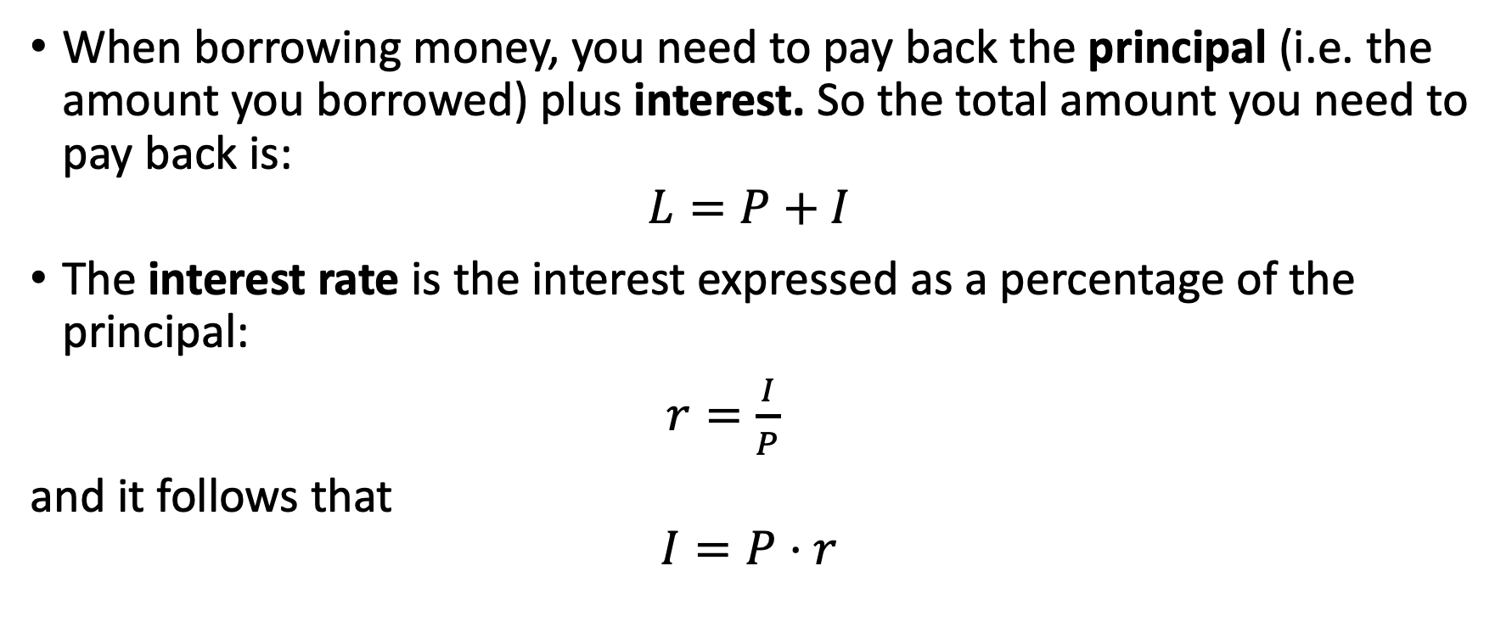
Interest
When borrowing money, you need to pay back the principal (i.e. the amount you borrowed) plus interest. So the total amount you need to pay back is:
$$L=P+I$$
The interest rate is the interest expressed as a percentage of the principal:
$r=\frac{I}{P}$
and it follows that
$$I=P⋅r$$

Slide 8
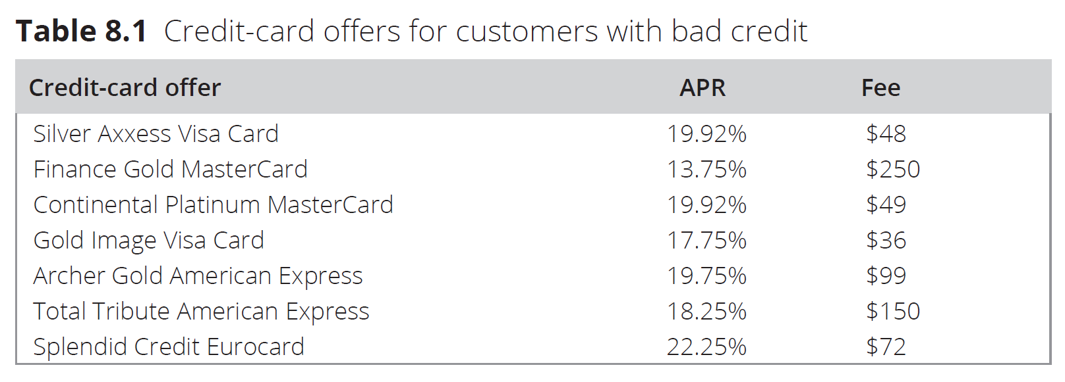
Interest: Examples
You borrow $1000 for one year. Which credit card will cost the most to pay back?

Slide 9

Interest
Let $R=1+r$
We can write:
$L=P+I$
$=P+\left(P⋅r\right)$
$=P\left(1+r\right)$
or
$L =P⋅R$

Slide 10
Simple vs Compound interest
Imagine you borrow €100 with your credit card, and the credit card company charges you an interest rate of 18% every month.
You pay the only interest every month. At the end of the year, you repay the €100 principal.
What is the total interest in euros you pay by the end of the year? As a percentage of the principal?

Slide 11
Simple vs Compound interest
Now, imagine that in the same situation, you do NOT pay the interest monthly, so it is added to the principal every month.
What is the total interest in euros that you pay by the end of the year? As a percentage of the principal?

Slide 12

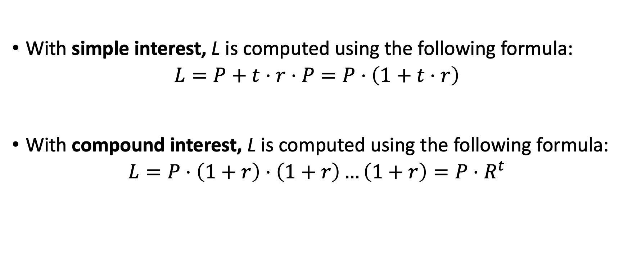
Simple vs Compound interest
With simple interest, L is computed using the following formula:
$$L=P+t⋅r⋅P=P⋅\left(1+t⋅r\right)$$
With compound interest, L is computed using the following formula:
$$L=P⋅\left(1+r\right)⋅\left(1+r\right)…\left(1+r\right)=P⋅R^{t}$$
$t$times

Slide 13
Example
You put €100 into a savings account. Your bank promises an annual interest rate of 10%.
What is your balance after 1 year? 2 years? 10 years?
What if the interest rate changes to 5%?

Slide 14
Exponential discounting

Slide 15
Time preference
What is better, €1000 today or €1000 in one year?
What is better, €100 now or €110 in one week?
What is better, €100 in three weeks or €110 in 4 weeks?
Different people may answer differently depending on their time preferences. But we expect almost everyone to agree with the first question: €1000 today is better than €1000 in one year.
If you also agree, then it means you discount the future.

Slide 16
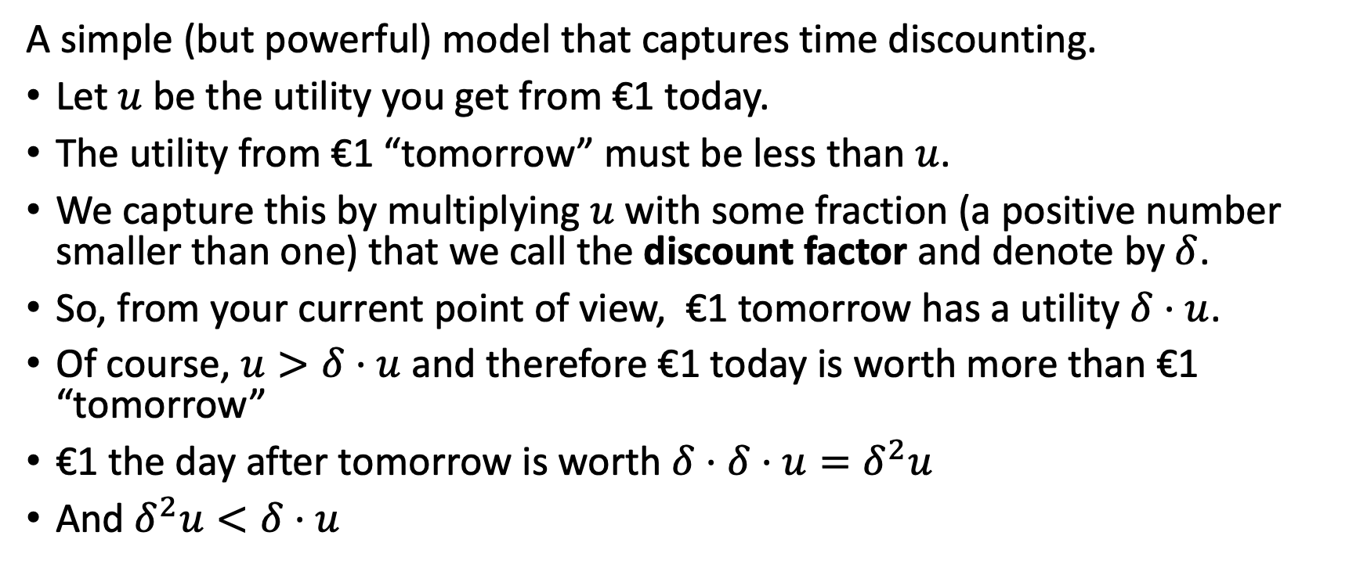
Exponential discounting
A simple (but powerful) model that captures time discounting.
Let $u$ be the utility you get from €1 today.
The utility from €1 “tomorrow” must be less than $u$.
We capture this by multiplying $u$ with some fraction (a positive number smaller than one) that we call the discount factor and denote by $δ$.
So, from your current point of view, €1 tomorrow has a utility $δ⋅u$.
Of course, $u>δ⋅u$ and therefore €1 today is worth more than €1 “tomorrow”
€1 the day after tomorrow is worth $δ⋅δ⋅u=δ^{2}u$
And $δ^{2}u<δ⋅u$

Slide 17
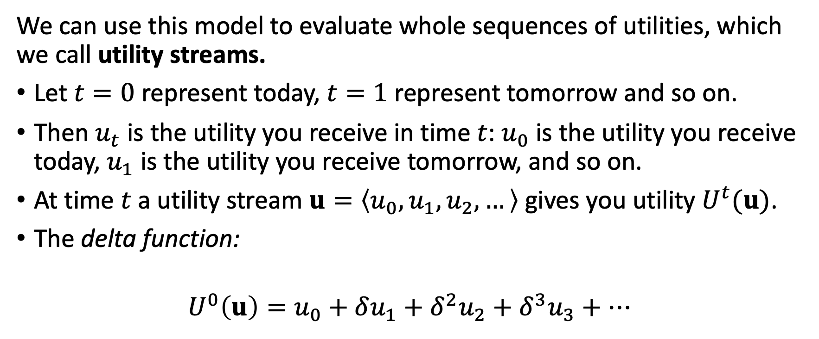
Exponential discounting
We can use this model to evaluate whole sequences of utilities, which we call utility streams.
Let $t=0$ represent today, $t=1$ represent tomorrow and so on.
Then $u_{t}$ is the utility you receive in time $t$: $u_{0}$ is the utility you receive today, $u_{1}$ is the utility you receive tomorrow, and so on.
At time $t$ a utility stream $u=\left\langle u_{0},u_{1},u_{2},…\right\rangle$ gives you utility $U^{t}(u)$.
The delta function:
$$U^{0}\left(u\right)=u_{0}+δu_{1}+δ^{2}u_{2}+δ^{3}u_{3}+…$$

Slide 18
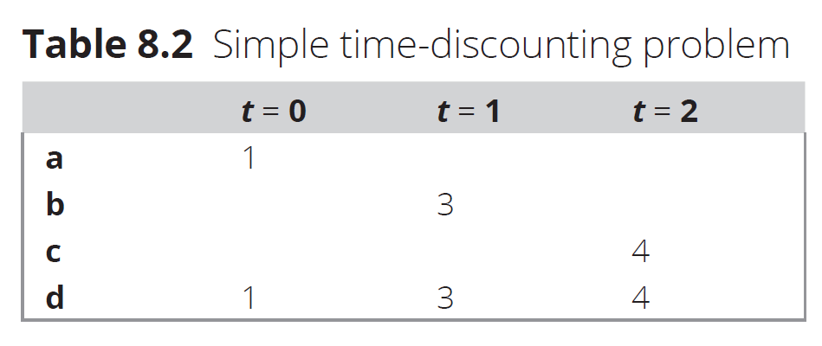
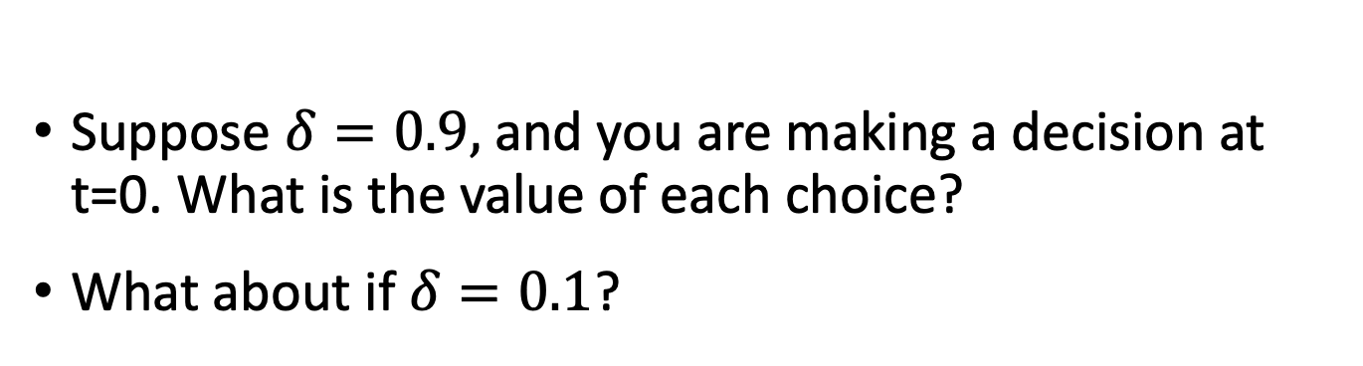
Example
Suppose $δ=0.9,$ and you are making a decision at t=0. What is the value of each choice?
What about if $δ=0.1$?

Slide 19
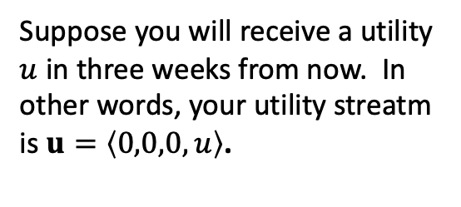






Graphically
$$U(x)$$
Suppose you will receive a utility $u$ in three weeks from now. In other words, your utility streatm is $u=\left\langle 0,0,0,u\right\rangle$.
$$u$$
$$t−3$$
$$t−2$$
$$t−1$$
$$t$$

Slide 20
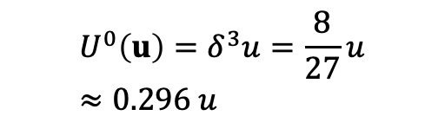
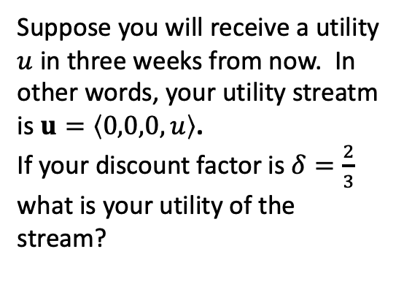
Graphically
$$U(x)$$
Suppose you will receive a utility $u$ in three weeks from now. In other words, your utility streatm is $u=\left\langle 0,0,0,u\right\rangle$.
If your discount factor is $δ=\frac{2}{3}$ what is your utility of the stream?
$$u$$
$${U^{0}\left(u\right)=δ}^{3}u=\frac{8}{27}u≈0.296 u$$
$$t−3$$
$$t−2$$
$$t−1$$
$$t$$

Slide 21



Graphically
$$U(x)$$
What will be the utility of the stream in one week from now?
In 2 weeks from now?
$$u$$
$$U^{2}\left(u\right)=δu$$
$${U^{1}\left(u\right)=δ}^{2}u$$
$${U^{0}\left(u\right)=δ}^{3}u$$
$$t−3$$
$$t−2$$
$$t−1$$
$$t$$

Slide 22


Graphically
$$U(x)$$
The higher a person’s δ, the higher and flatter will the corresponding curve be. It means this person is more patient.
The lower a person’s δ, the lower and steeper will the corresponding curve be. It means this person is less patient.
$$u$$
high $δ$
low $δ$
$$t−3$$
$$t−2$$
$$t−1$$
$$t$$

Slide 23
Graphically
$$U(x)$$
This person would be indifferent between options (a) and (b), which represent two different streams of utility.
$$u$$
(a)
(b)
$$t−3$$
$$t−2$$
$$t−1$$
$$t$$

Slide 24
Graphically
$$U(x)$$
Which of the three options would this person prefer?
$$u$$
(b)
(c)
(a)
$$t−3$$
$$t−2$$
$$t−1$$
$$t$$

Slide 25
Time preferences and rationality
Is there a rational δ?
A very low discount factor means you aim for instant gratification.
A very high discount factor means you are very patient.
Both cases are considered rational in this context and simply represent different time preferences.
A very important feature of the model is that it implies time consistency.

Slide 26
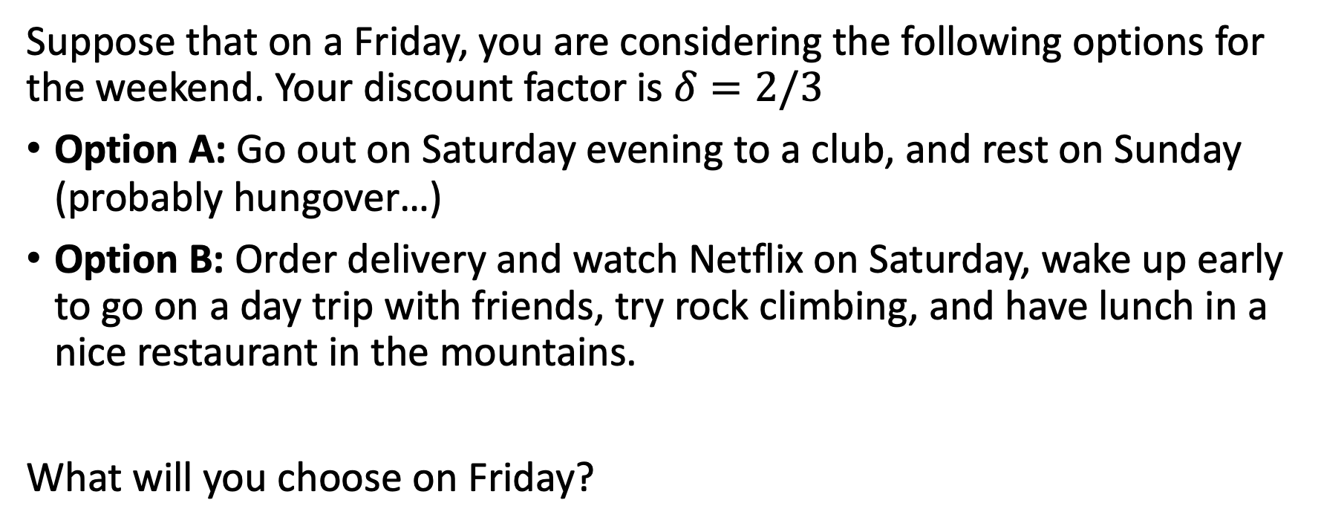
Example
Suppose that on a Friday, you are considering the following options for the weekend. Your discount factor is $δ=2/3$
Option A: Go out on Saturday evening to a club, and rest on Sunday (probably hungover…)
Option B: Order delivery and watch Netflix on Saturday, wake up early to go on a day trip with friends, try rock climbing, and have lunch in a nice restaurant in the mountains.
What will you choose on Friday?
 | t = 0 | t = 1 | t = 2
A | 0 | 4 | 3
B | 0 | 1 | 12

Slide 27
Your friends want you to confirm on Saturday that
you are going on the trip with them on Sunday. Will you change your mind?

Slide 28
Example
On Friday
On Saturday
 | t = 0 | t = 1 | t = 2
A | 0 | 4 | 3
B | 0 | 1 | 12
 | t = 0 | t = 1
A | 4 | 3
B | 1 | 12

Slide 29
Present bias & Hyperbolic discounting

Slide 30
Time inconsistency
One can think of many examples where individuals are not time-consistent:
“I will start a diet tomorrow…”
Procrastination
This is typically associated with present bias: the tendency to put a very high weight on immediate utility versus anything happening in the future (near or far).
Notice: This is not exactly the same as being impatient!!!
A highly impatient individual would not start a diet as they do not appreciate the future health benefits.
A person with present bias plans to start a diet tomorrow but prefers to delay it when the time comes, opting for something tasty instead. This inconsistency is common.

Slide 31

Time-consistent preferences
$$U(x)$$
At any point in time, patient person high discount factor) will choose option (b). This can be seen as the corresponding curve for (b) is always above the one for (a).
An impatient person will choose option (a) at any point in time. The corresponding curve is always above the one for (b).
patient
(a)
(b)
impatient
$$t−2$$
$$t−1$$
$$t$$

Slide 32
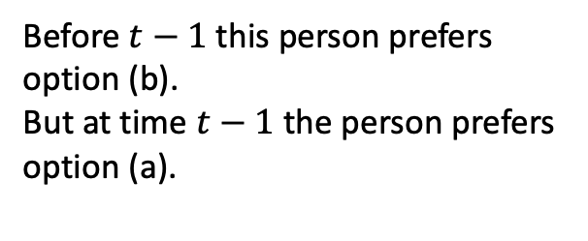
Time-inconsistent preferences
$$U(x)$$
Before $t−1$ this person prefers option (b).
But at time $t−1$ the person prefers option (a).
(a)
(b)
$$t−2$$
$$t−1$$
$$t$$

Slide 33
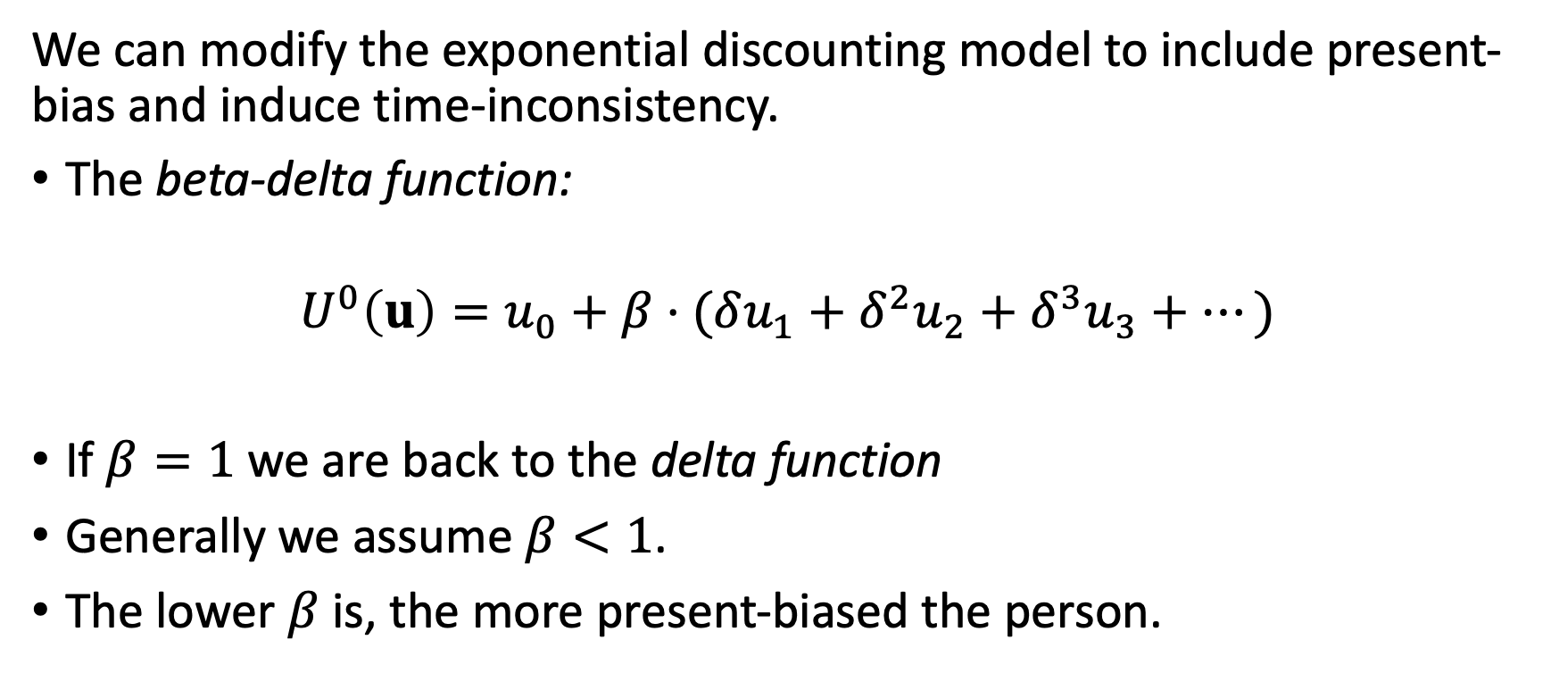
Hyperbolic discounting
We can modify the exponential discounting model to include present-bias and induce time-inconsistency.
The beta-delta function:
$$U^{0}\left(u\right)=u_{0}+β⋅(δu_{1}+δ^{2}u_{2}+δ^{3}u_{3}+…)$$
If $β=1$ we are back to the delta function
Generally we assume $β<1$.
The lower $β$ is, the more present-biased the person.

Slide 34
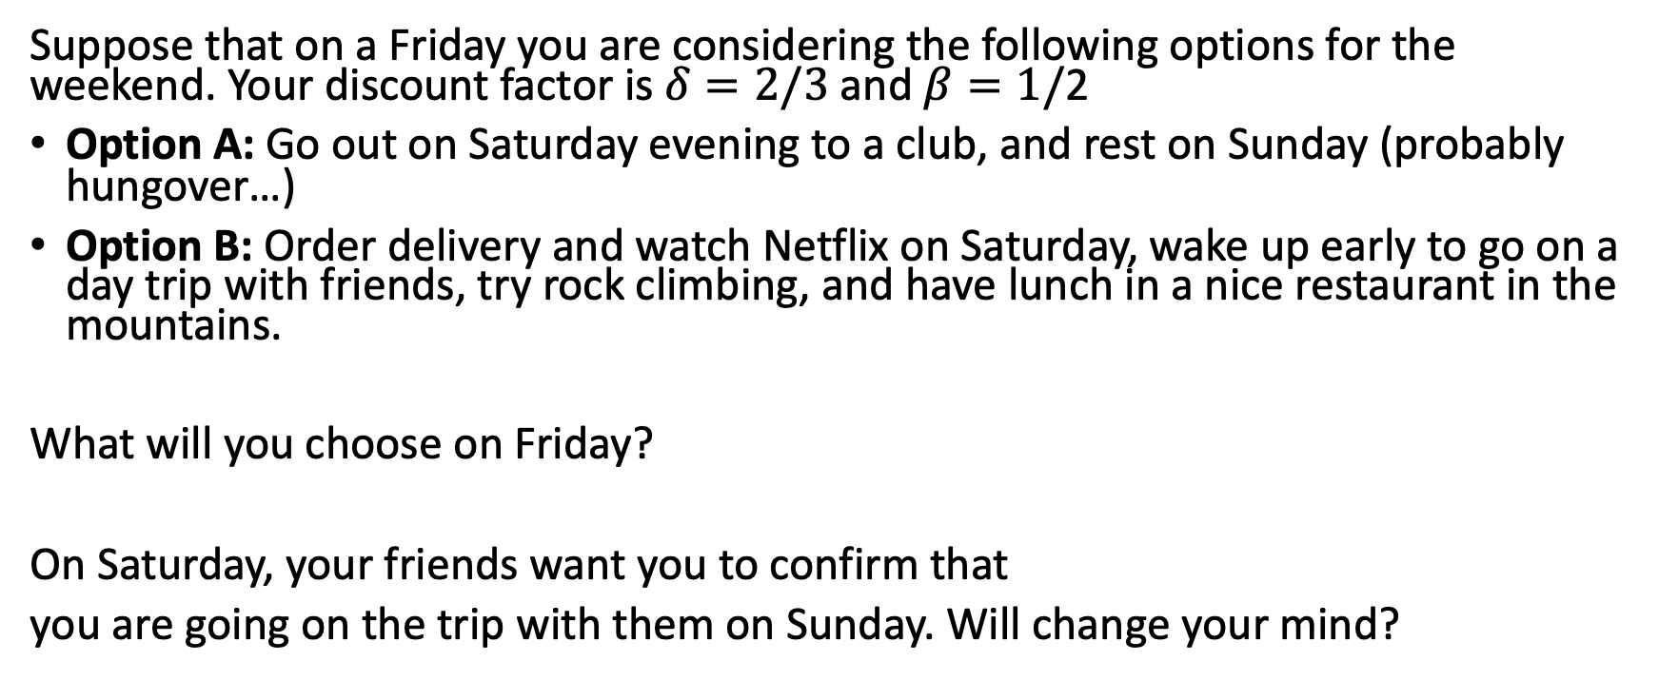
Example
Suppose that on a Friday you are considering the following options for the weekend. Your discount factor is $δ=2/3$ and $β=1/$2
Option A: Go out on Saturday evening to a club, and rest on Sunday (probably hungover…)
Option B: Order delivery and watch Netflix on Saturday, wake up early to go on a day trip with friends, try rock climbing, and have lunch in a nice restaurant in the mountains.
What will you choose on Friday?
On Saturday, your friends want you to confirm that
you are going on the trip with them on Sunday. Will change your mind?
 | t = 0 | t = 1 | t = 2
A | 0 | 4 | 3
B | 0 | 1 | 12

Slide 35
Example
On Friday
On Saturday
 | t = 0 | t = 1 | t = 2
A | 0 | 4 | 3
B | 0 | 1 | 12
 | t = 0 | t = 1
A | 4 | 3
B | 1 | 12

Slide 36
Naïve and Sophisticated Discounters
Naïve discounters assume that their future preferences will be exactly the same as their preferences today.
Sophisticated discounters assume that their future preferences will be different because of self-control problems.
Save money in a piggy bank that you need to break to get back.
Putting the alarm clock far from the bed.

Slide 37
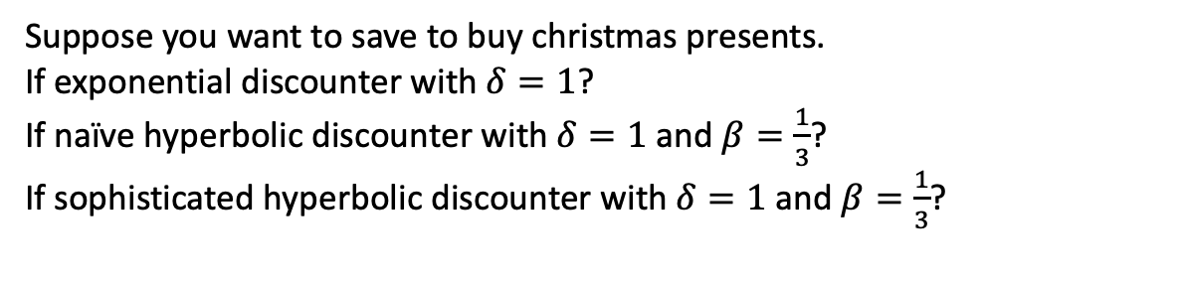
Example
Suppose you want to save to buy christmas presents.
If exponential discounter with $δ=1$?
If naïve hyperbolic discounter with $δ=1$ and $β=\frac{1}{3}$?
If sophisticated hyperbolic discounter with $δ=1$ and $β=\frac{1}{3}$?
In October
In November
 | Oct | Nov | Dec
save-save | 3 | 3 | 27
save-spend | 3 | 9 | 15
spend-spend | 6 | 6 | 9
layaway | 2 | 3 | 27
 | Nov | Dec
save | 3 | 27
spend | 9 | 15

